Slide 1
ClubRunner Essentials
Learn to use some of the fundamental sections of ClubRunner

Slide 2
What is ClubRunner?
ClubRunner is a cloud-based software service that manages organization and membership information, as well as facilitates easier communication between the various levels of an organization.
ClubRunner:
Is a private software company that has been serving thousands of service clubs worldwide for over 20 years.
Is a collaborative, web-based tool designed to allow members to collectively share and maintain their data.
Can handle small clubs with just a few members, all the way up to multi-level organizations with thousands of members.

Slide 3
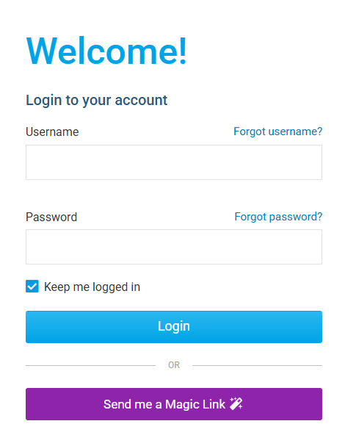
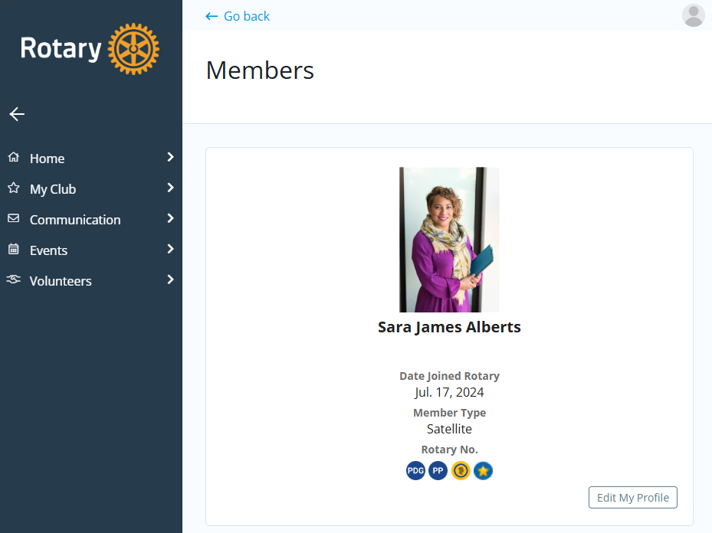
How do I log in?
1
At the top right-hand corner of clubrunner.ca, click the ‘Log In’ button:
2
If you don’t know your login credentials, click “Forgot Username?” or “Forgot Password?” and follow the steps to reset them.
3
Follow the on-screen steps and you will be directed to the Members Area of your club.
Help article: How do I login?

Slide 4
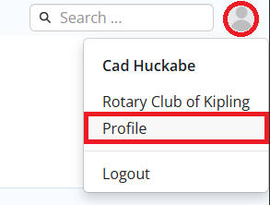
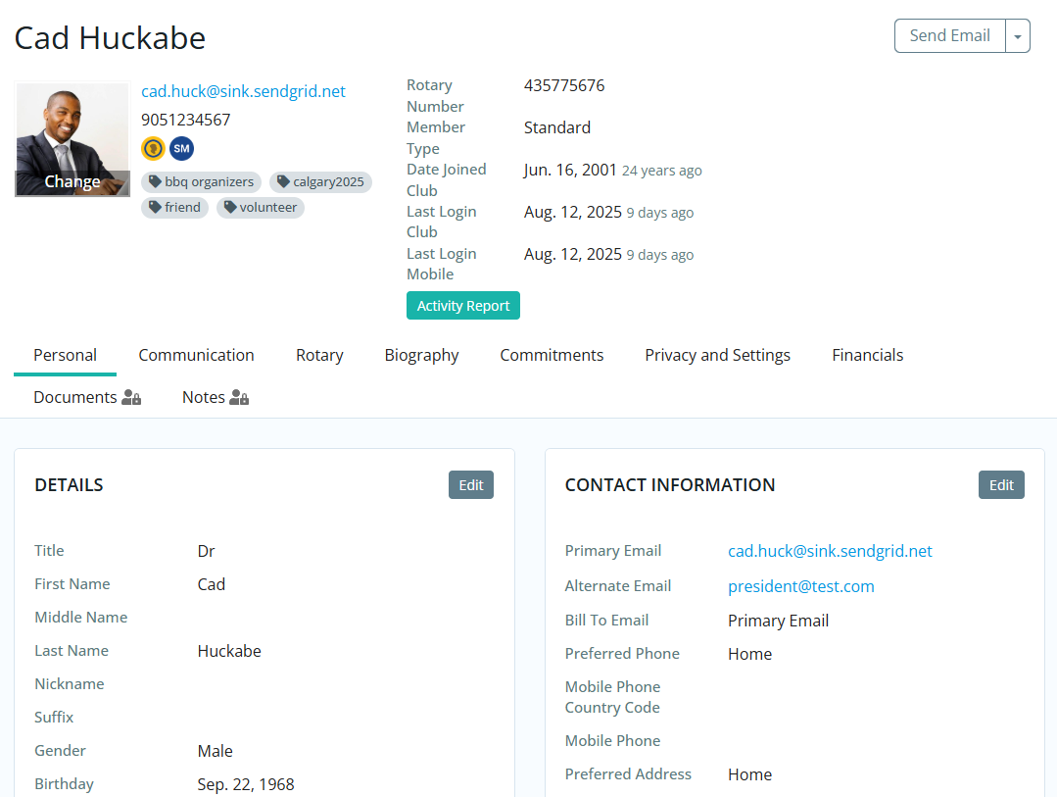
How do edit my profile?
In the top right-hand corner of the Members Area,
click your profile icon and then click Profile.
Inside your profile, below your photo, there are several tabs such as:
Personal | Rotary | Biography | etc. Select any of these tabs. These tabs contain all the different sections of your profile you can edit. Click the Edit button to edit your information.
1
2
Help article: How do I access & change my profile information?

Slide 5
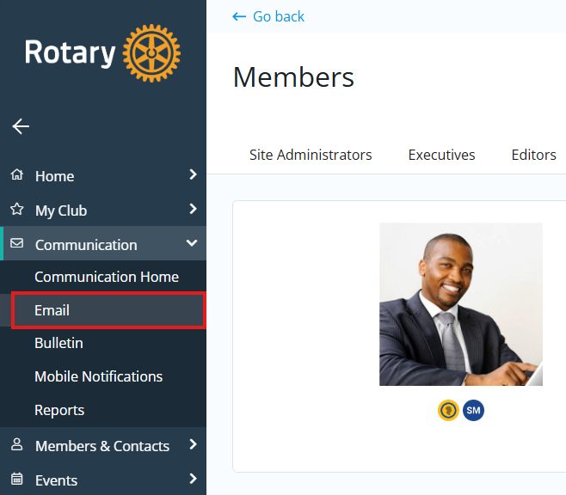
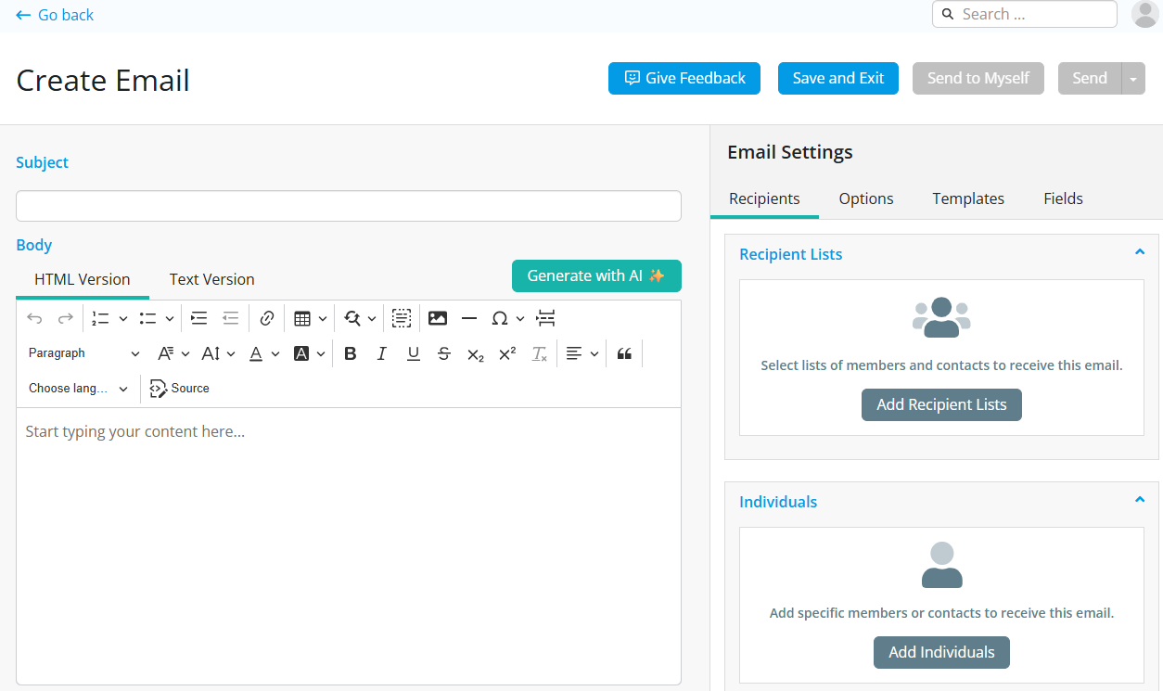
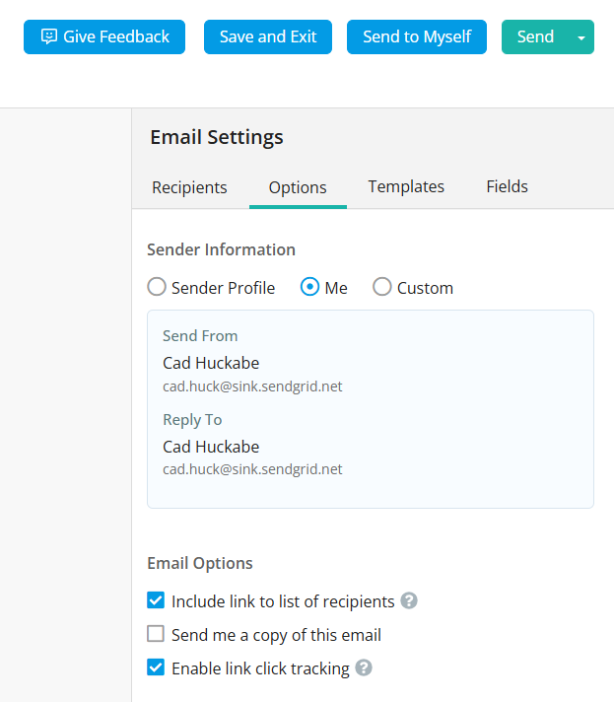
How do I send email?
1
2
3
Along the left-hand menu click:
Communication > Email, then
Compose new message.
Step 1 = compose the subject and body of email
Step 2 = add attachment if necessary
Step 3 = select a list of recipients; cc yourself
Step 4 = edit options like sender profiles
Step 5 = send now, or schedule email for later
Help article: How do I send email?

Slide 6
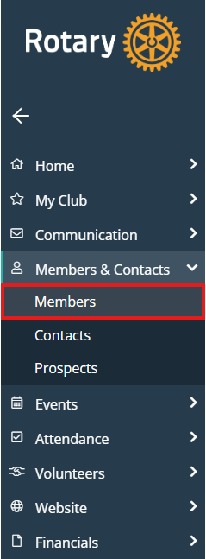
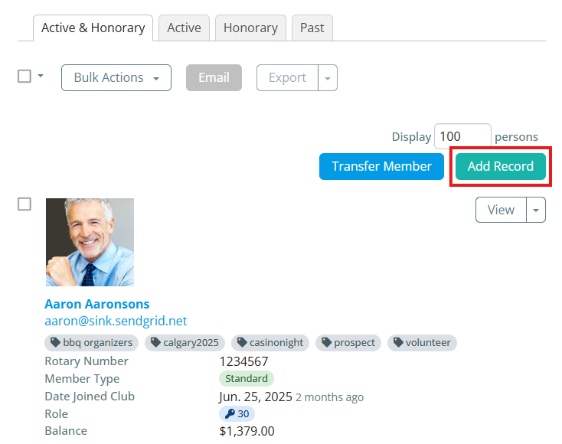
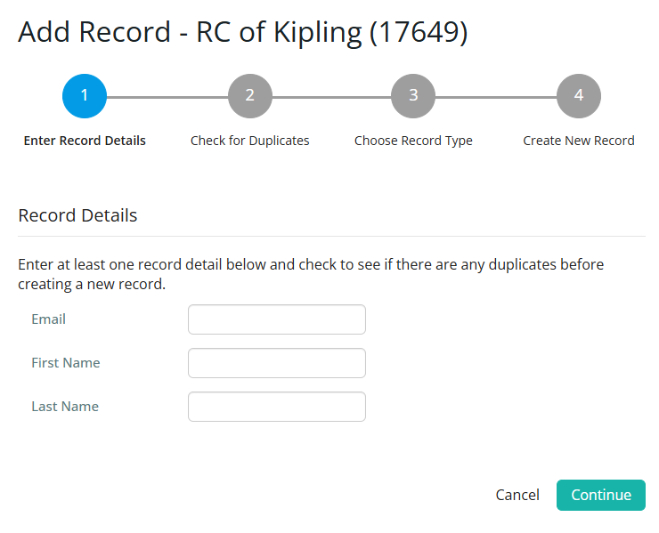
How do I add a new member?
1
Along the left-hand menu navigation,
click Members & Contacts > Members:
2
Click the Add Record button above the list of member records.
3
Follow the prompts to fill in all appropriate information. Fields marked with a blue asterisk * are required.
Note that these are the minimum required fields, you can input more information later.
Help article: How do I add a new member?

Slide 7
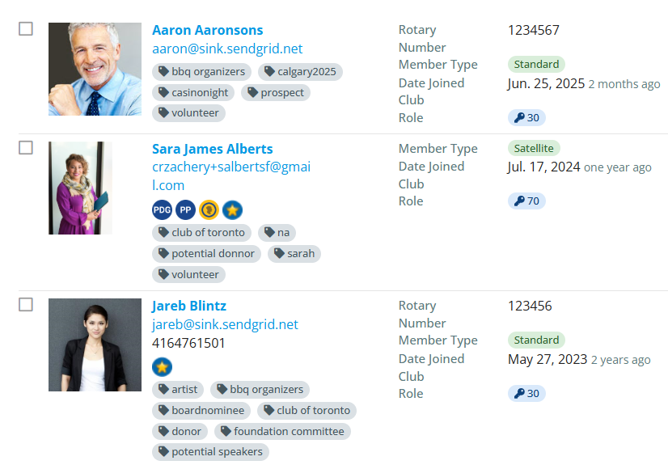
How do I edit an existing member?
1
Along the left-hand menu navigation,
click Members & Contacts > Members:
2
Click on any member’s name.
3
This takes you to the member’s profile. Change any information by clicking the Edit buttons.
Note: on the club website only members with access
levels of 50, 40 and 30 can edit other member profiles.
Help article: How do I add a new member?

Slide 8
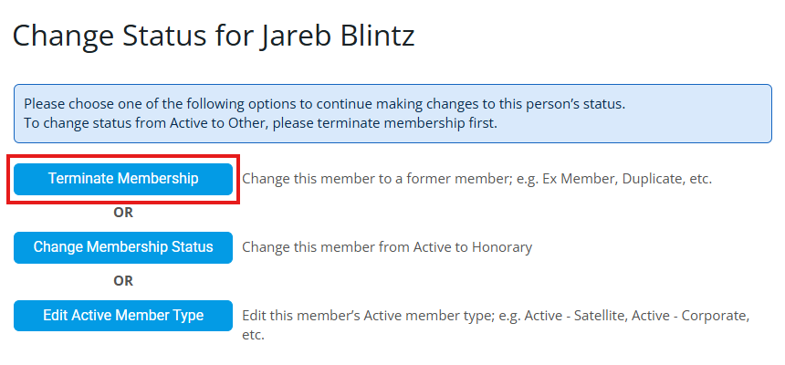
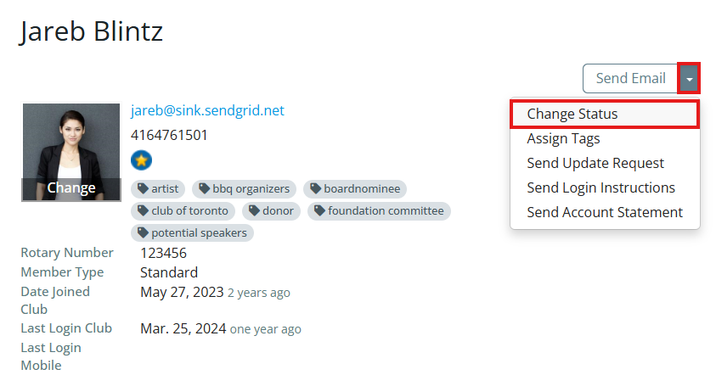
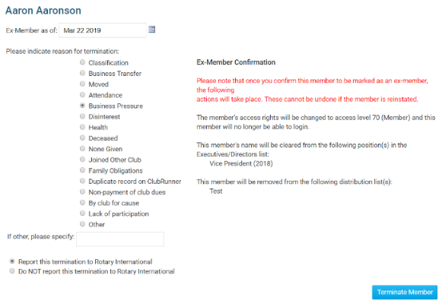
How do I terminate a member?
3
On the Change Status screen, click
Terminate Membership.
1
Navigate to a member’s profile.
2
Click the drop-down arrow in the top right-hand corner of the page, then click Change Status.
4
You must choose a reason for termination to activate the blue Terminate Member button.
Except in special cases, always choose Report this termination to Rotary International.
Help article: How do I terminate or delete an active member?

Slide 9
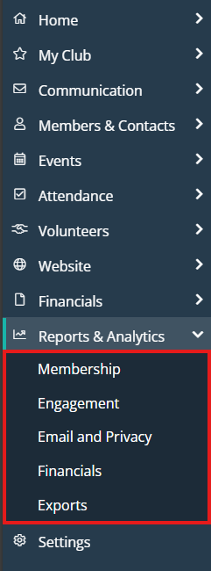
How do I access reports?
Along the left-hand menu navigation, click Reports & Analytics to reveal the report options we have.
Available reports include:
edirectory Reports 2.0 - a collection of printable member reports in PDF and MS Word format
edirectory Builder 2.0 - create your own printable member reports
Club Dashboard - various membership reports that automatically update monthly
Years of Service - how many years of service each member has contributed to Rotary
Age Distribution - age demographic breakdown of your club
Gender Distribution - gender demographic breakdown of your club
Rule of 85 - members in your club who qualify as Rule of 85, sometimes called Senior Active
Birthdays & Anniversaries - member and spouse birthdays and anniversaries
Login Activity - which members have logged into the website Member Area, and when
Download Member Data - create custom MS Excel files using all member data that we store
Member Activity - a breakdown of member’s activities and participation in the club
Club Activity - Overall member participation, including events and club activities at a glance

Slide 10
Help Resources
www.ClubRunnerSupport.com
support@clubrunner.ca
1-877-469-2582

