Slide 1



District Nova Release
Oct 20 2026

Slide 2


Agenda
Nova Overview
What’s New for Districts
LIVE DEMO
How to Switch
Q&A

Slide 3
Why we built Nova
Modern and powerful infrastructure
Simplified navigation and easier to use
Unify and consolidate data and modules
Better member engagement and tracking
New mobile app and upgraded technology
Better performance and security
Flexibility and configurability

Slide 4
The Power of Nova
A robust platform that will keep getting even better; this is just the beginning.
360° Member Profiles
Visual Dashboards & Reporting
👤
📊
Members, contacts, and prospects unified. See all activity, notes, and documents in one view.
Real-time insights that help club leaders make better decisions, faster.
New Billing & Financials
Smarter Communication
💳
✉️
Modern batching, unified financial reporting, and simplified dues management.
Smart lists, sender profiles, automated campaigns, and club intercommunication built in.
Form Builder
Automations
📋
🔄
Build custom forms for any need; surveys, applications, nominations, and more.
Automated emails to celebrate milestone dates such as birthdays and anniversaries.

Slide 5
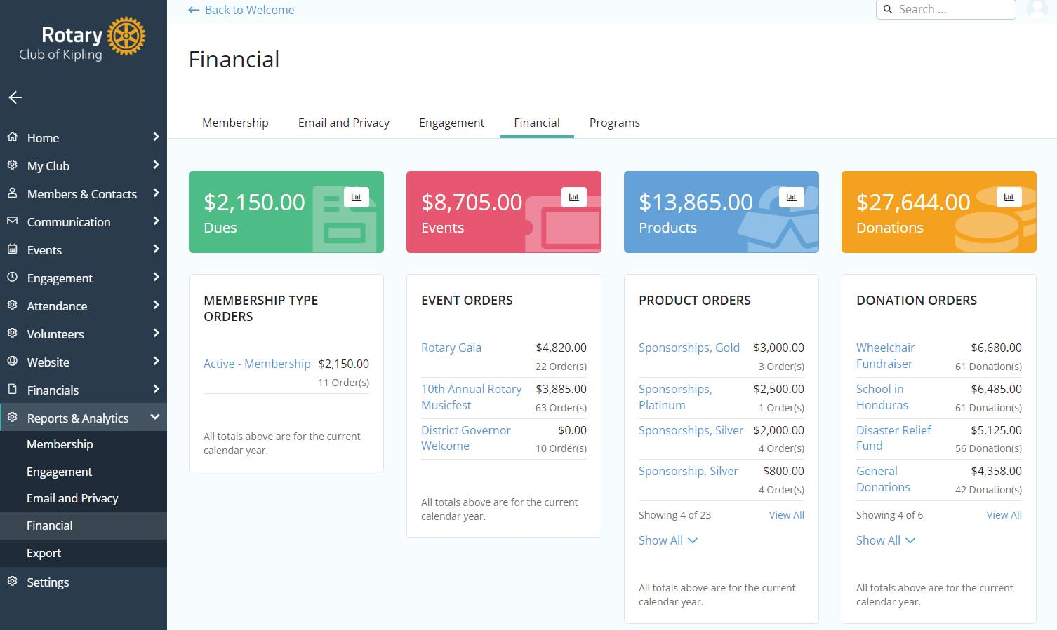
New in Nova
Modernized and Intuitive Navigation
Database Unification (Members + Contacts)
Email AI Generation
Custom Email Segments (Smart Lists)
Automated Campaigns
  Celebrate member birthdays
  Highlight member anniversaries
Form Builder
Sender Profiles
Unified Financial Reporting
  Account Wallet for Members
  Bulk Payments
  Automated Invoice Reminders
QR Code Generator

Slide 6
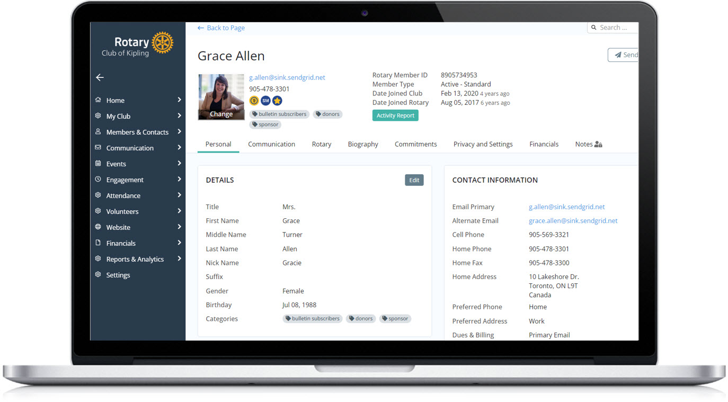
Members and Contacts
Member Database: Secure, centralized profiles with contact info, roles, history, and status, tags, custom fields and more.
Member Directory:
Customizable, searchable directory for members with privacy options.
Engagement Tracking:
Monitor participation, event attendance, donations and contributions for both members and contacts.
Custom Tags: Organize members and contacts by tags such as interest, skill, and more for better reporting and targeting.

Slide 7
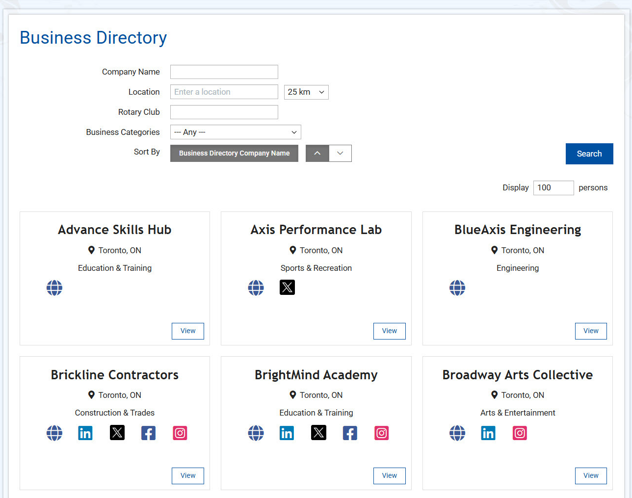
New for Districts
New Financials
  Simplified billing and reporting
Business Directory
  Greater value and visibility for members
Groups
  Easier committee and special interest management
Assistant Governor Dashboard
  Deeper insight across assigned clubs
Modernized Club Details pages
  Clearer, more intuitive club view
and more!

Slide 8
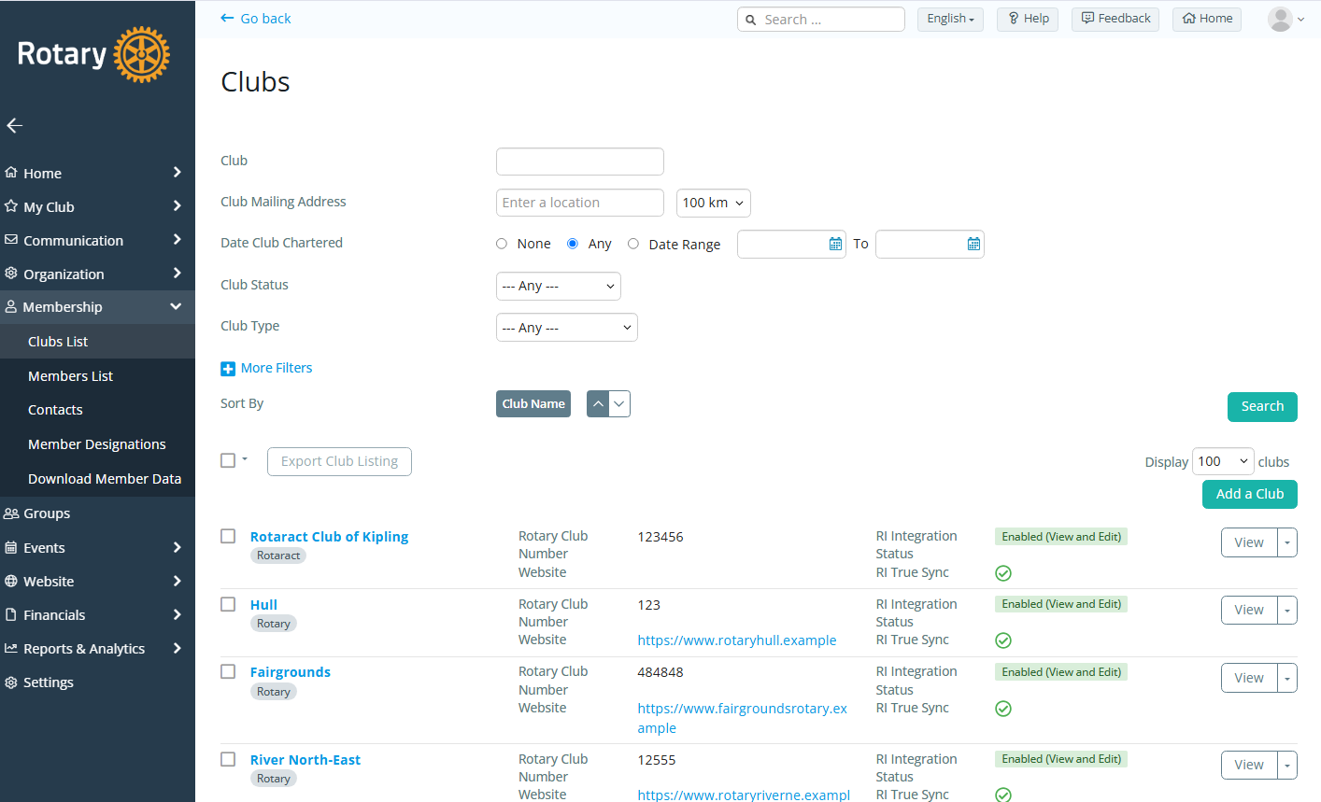
Club Directory
Easily search for any club
View RI Integration Settings
Filter by Club Type
Export Information Easily
and more!

Slide 9
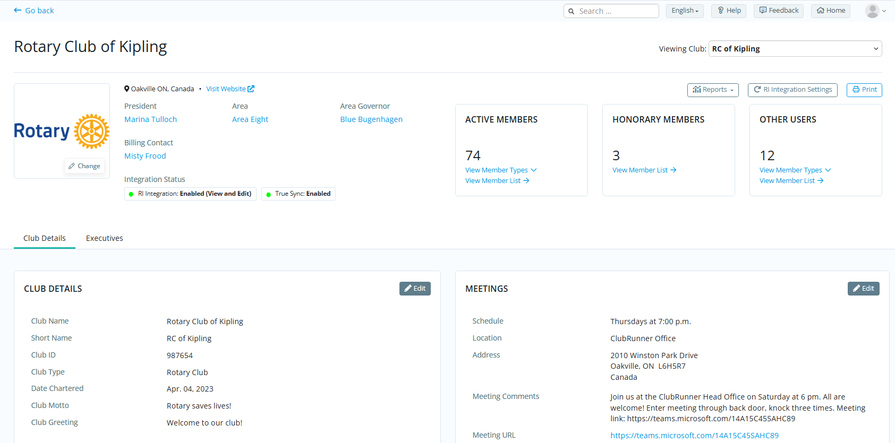
Club Details

Slide 10
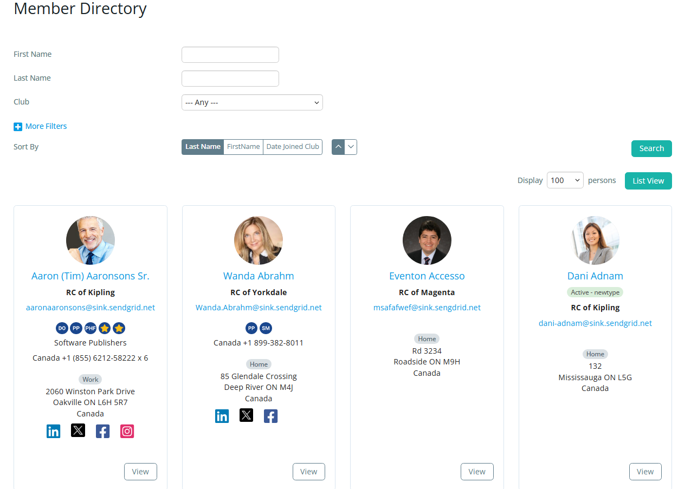
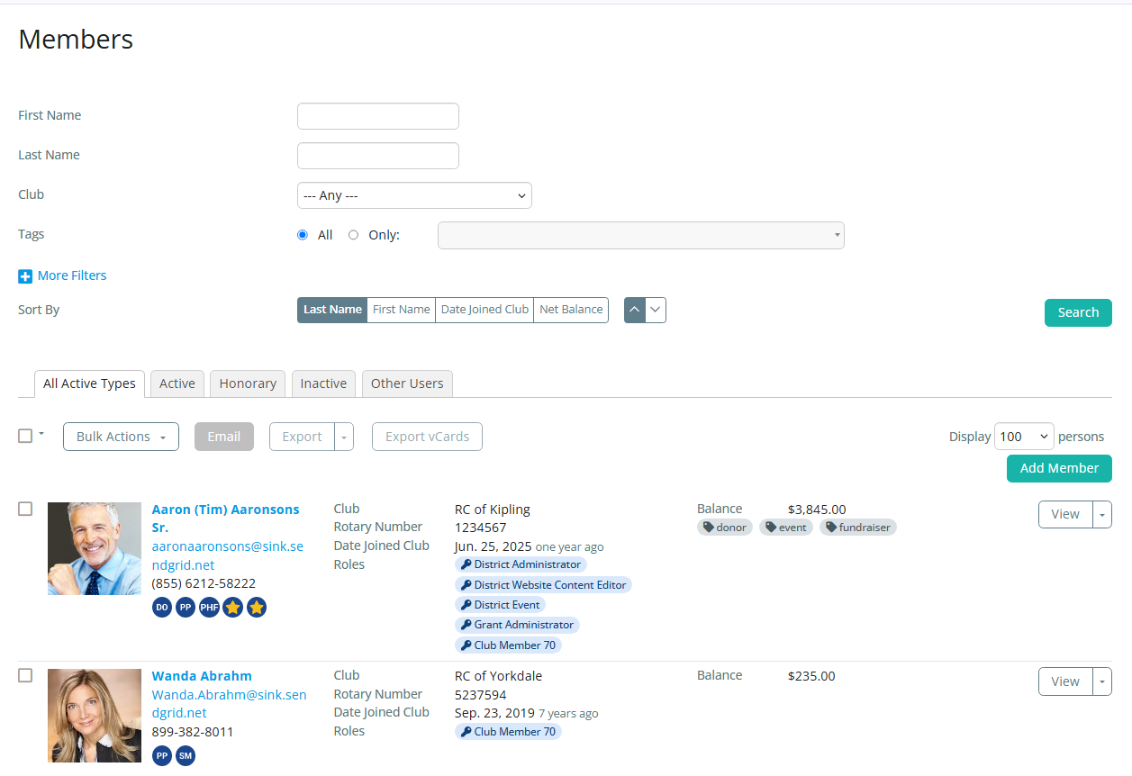
Member Directory

Slide 11
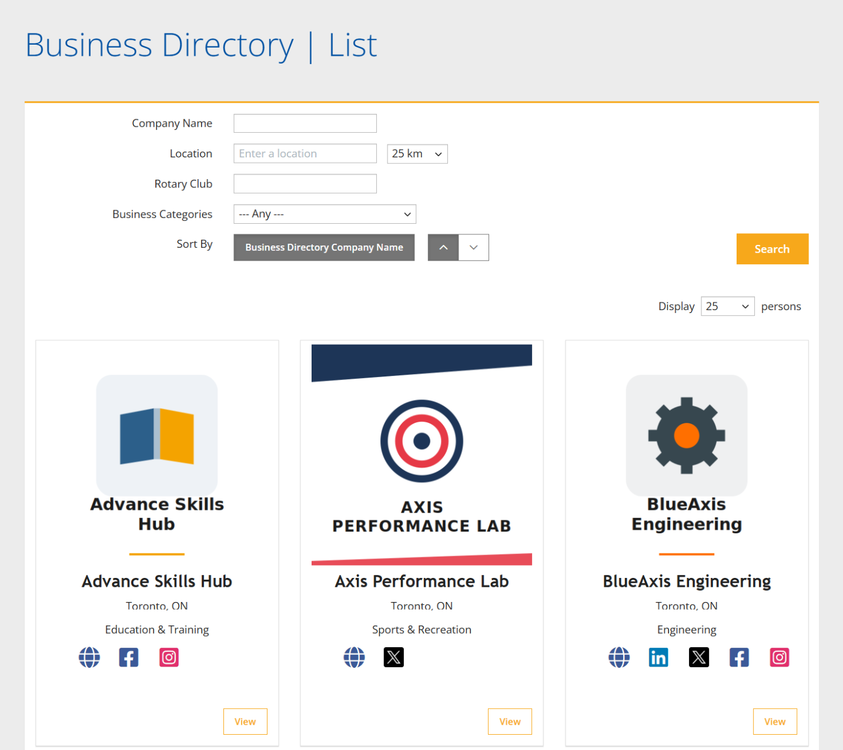
Business Directory
Give members the added benefit to promote their businesses
Opt in by member
Publicize their offering with a description and video
Searchable directory on website

Slide 12
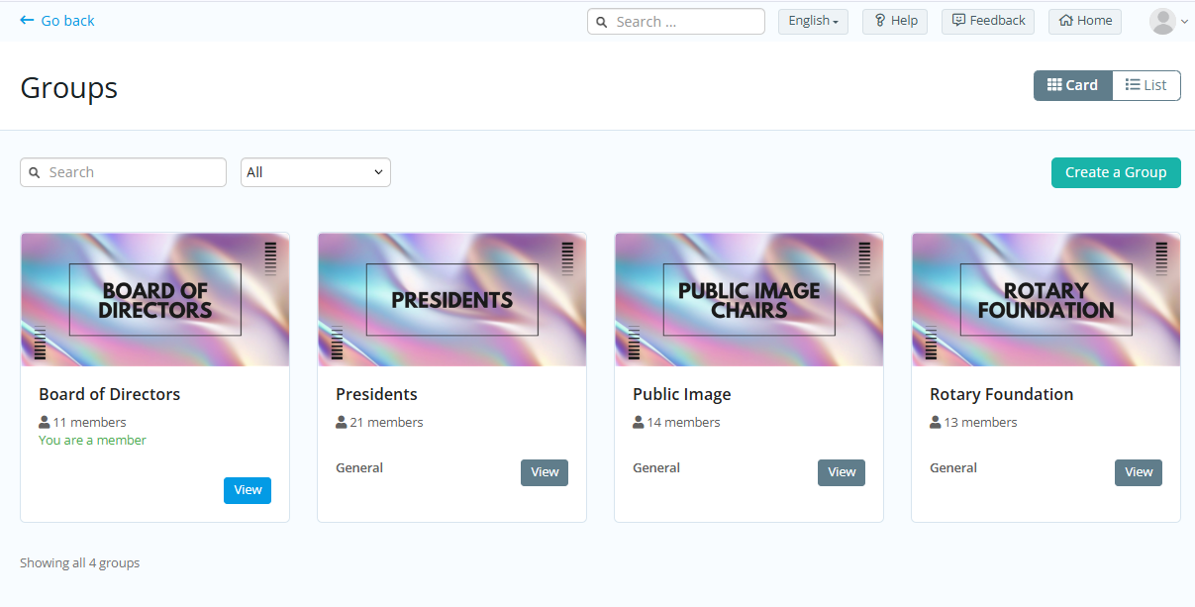
Groups
Private or public groups
Store documents
Send emails
Manage group events
Dynamic membership by smart list

Slide 13
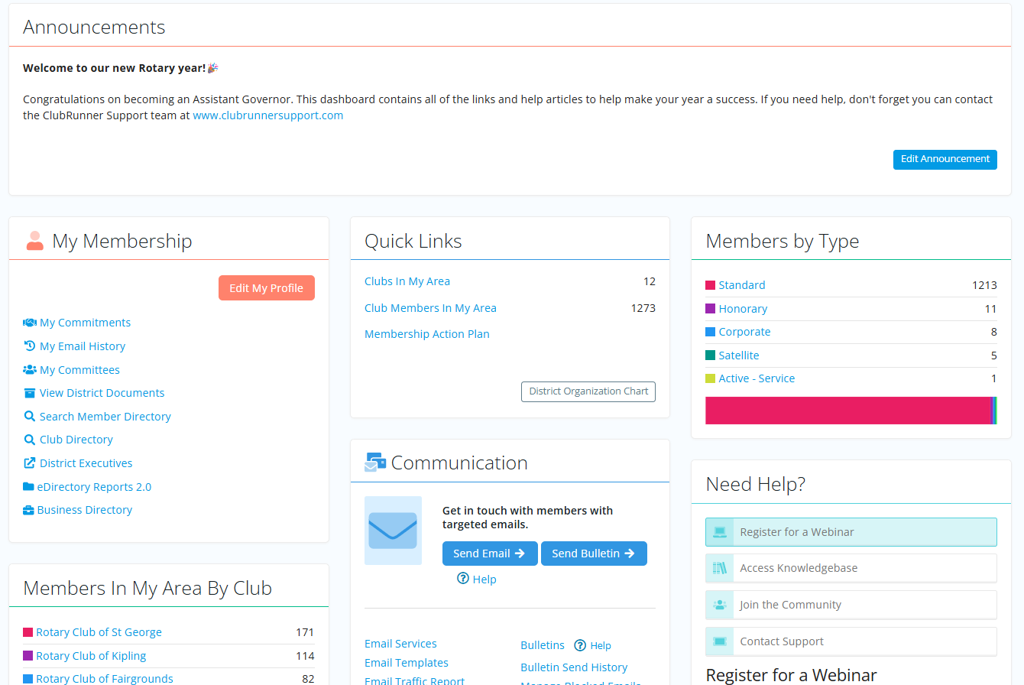
Assistant Governor Module
Dedicated space for AG’s to track their clubs
Gain insights through statistics and reports
View and email members
and more

Slide 14
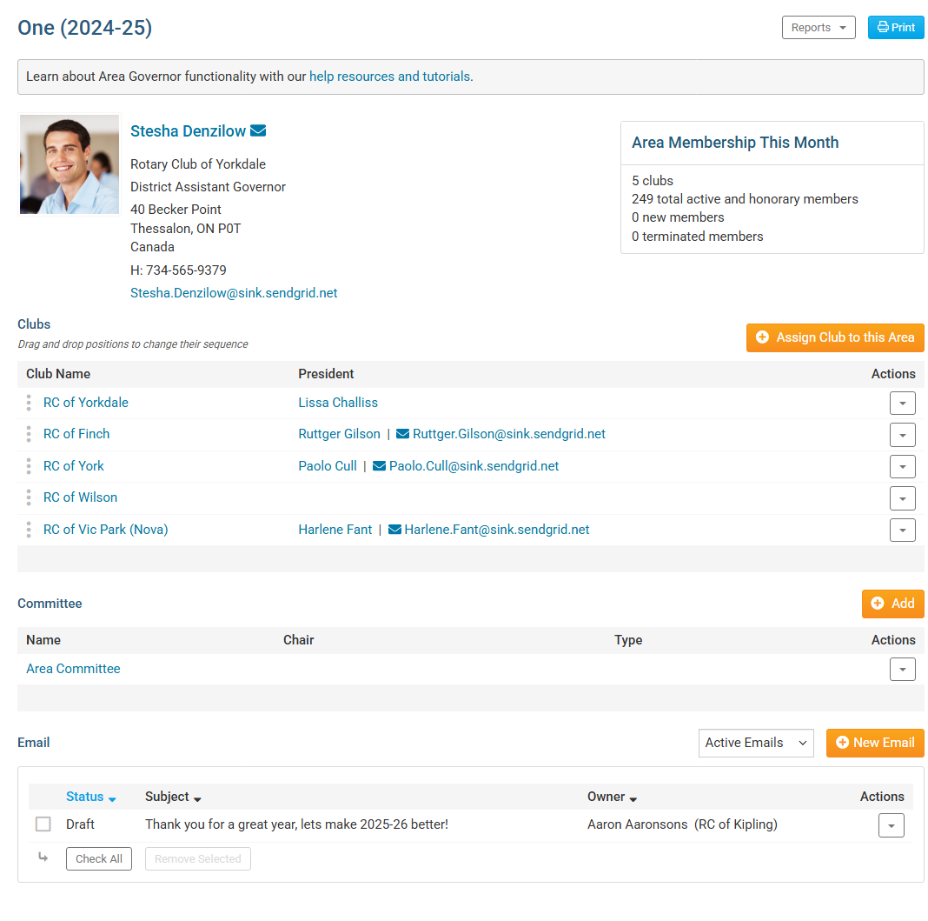
Assistant Governors
Snapshot of club demographics
Drill down to manage club data
Create Area specific committees
Email only area club executives
or members

Slide 15
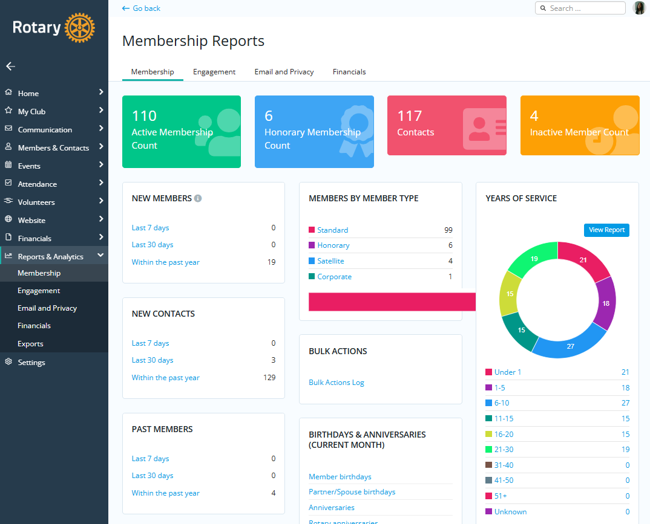
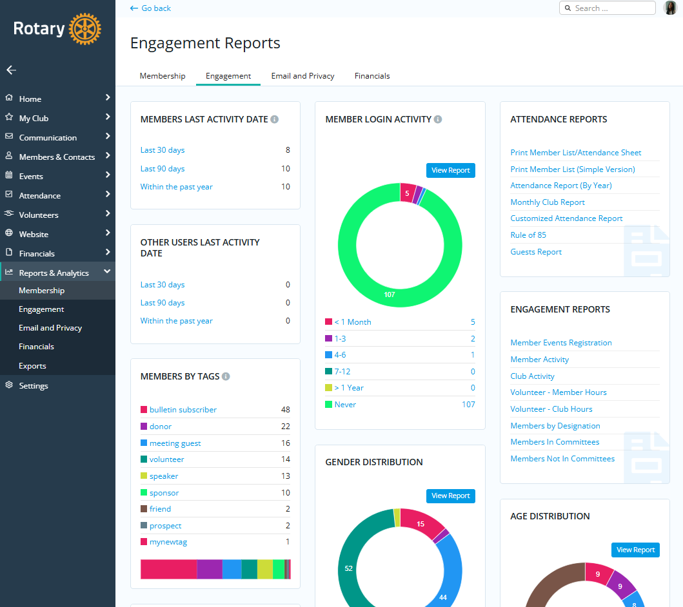
Membership & Engagement Reporting

Slide 16
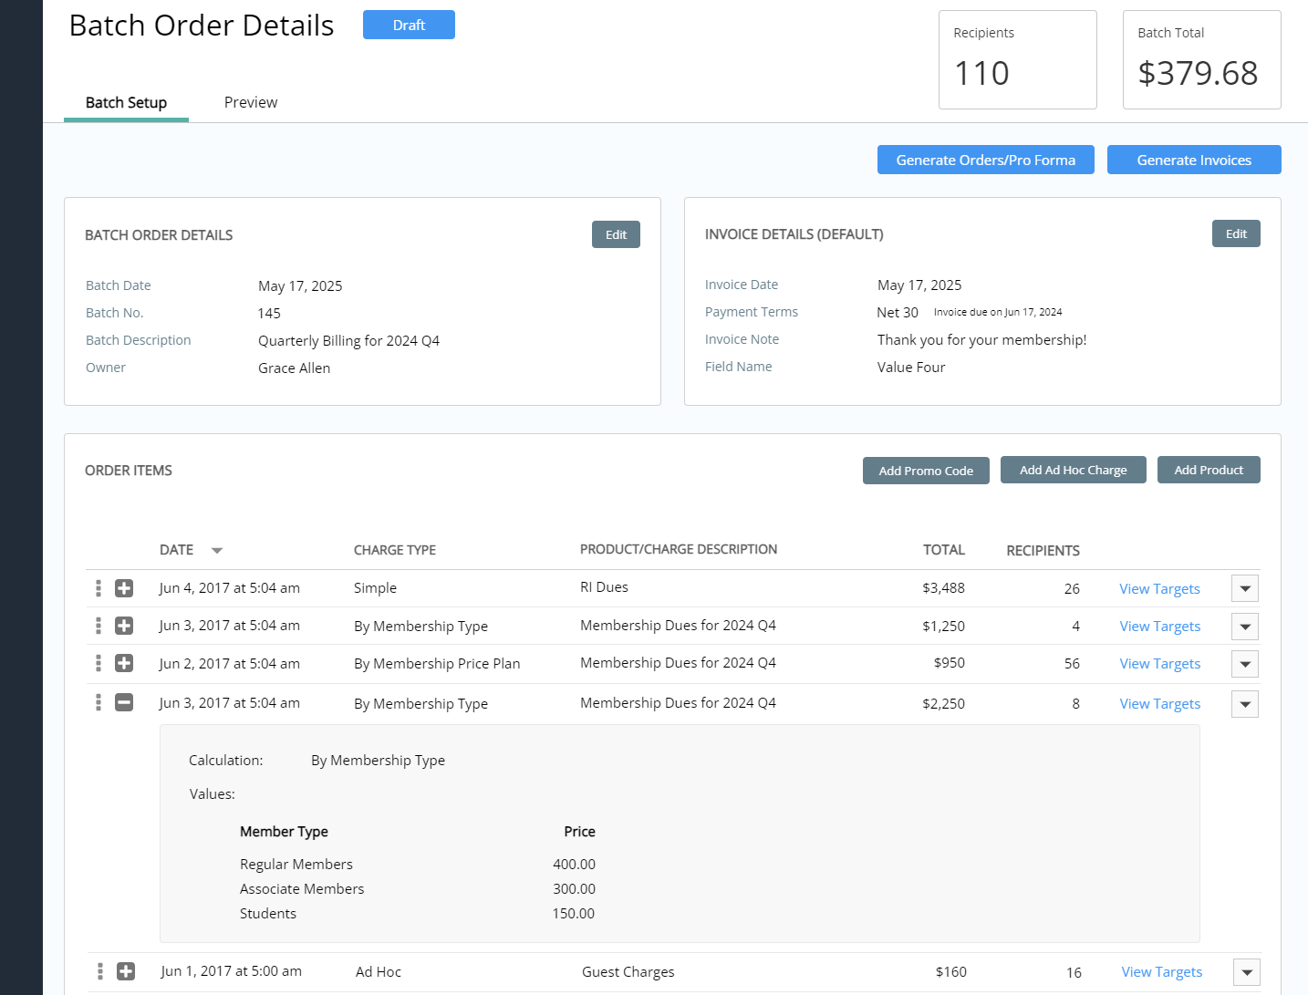
Modernized Financials
Invoice any club, member, or contact
Batch dues with multiple line items
Optional donations that can be edited
Bulk apply payments
Aggregated reporting across new modules
Categorize line items into accounts (Dues revenue, events, donations, etc.)
More granular export capabilities
  Invoice items
  Payments
  Refunds

Slide 17
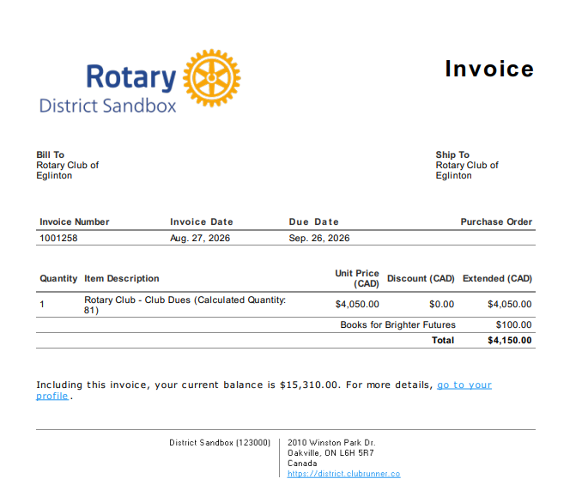
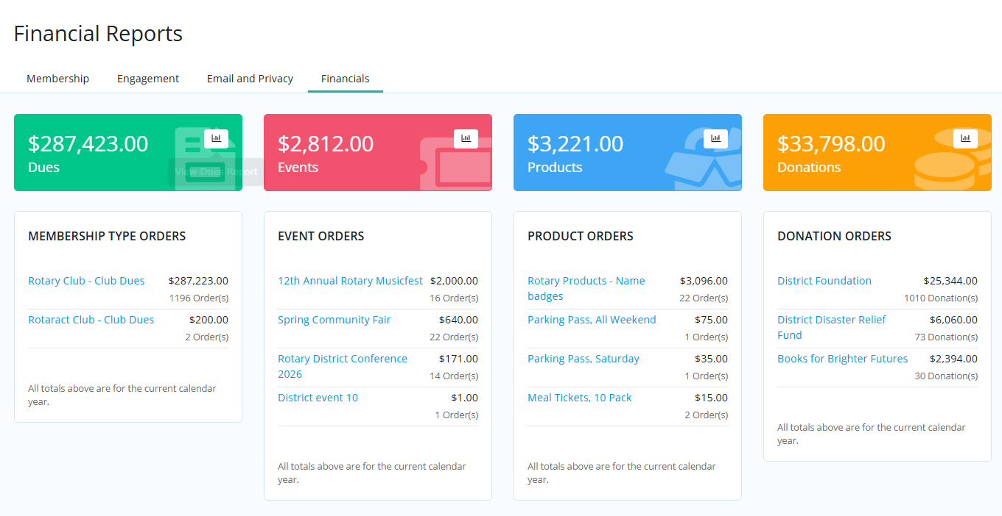
District Financials

Slide 18
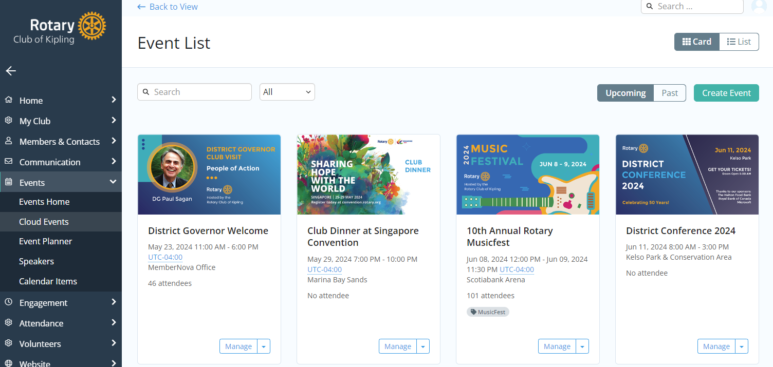

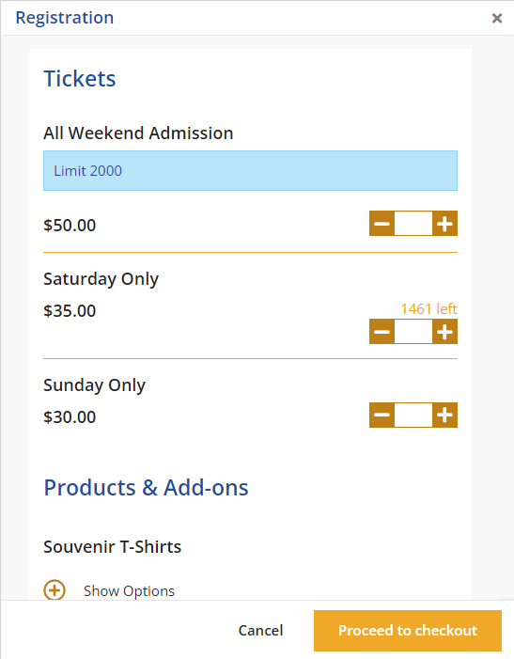
Cloud Events
Cloud events makes planning events a breeze. Add flexible event registration and ticket sales to your fundraising efforts. Set up multiple ticket types, add-on products and options, donations, custom questions, and more.

Slide 19

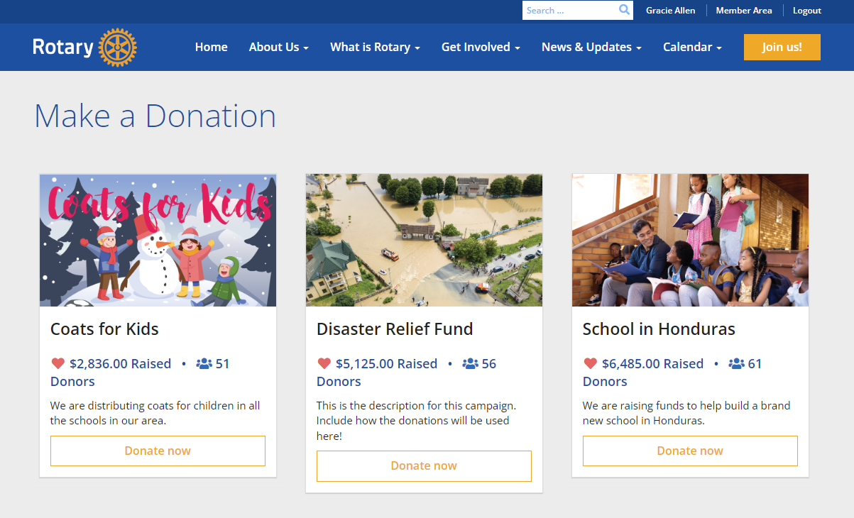
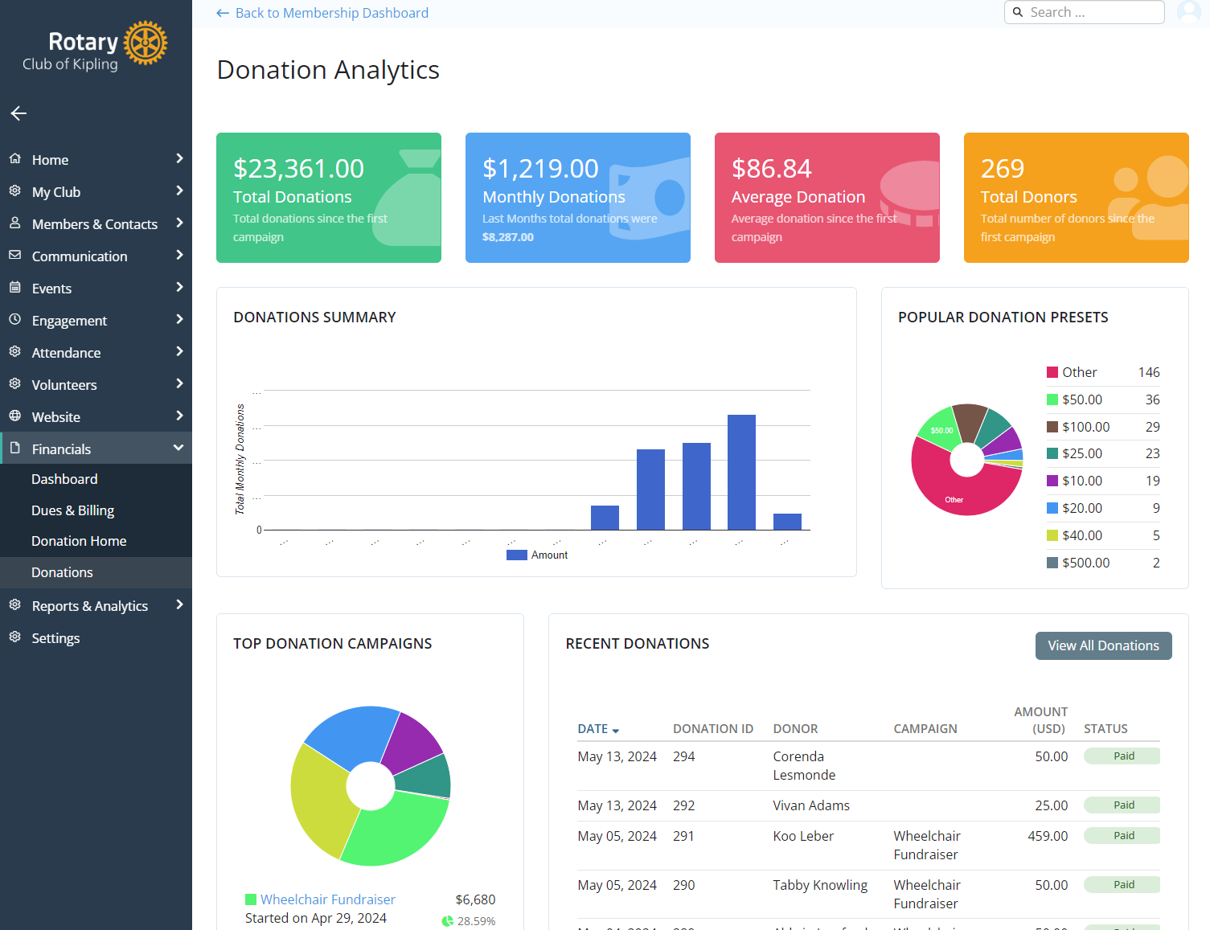
Donations and Fundraising
Our new donations module makes fundraising a breeze with a public landing page and seamless transactions, campaigns, and customization options.

Slide 20




Payment Gateways
NEW
NEW
Paya (Formerly Sage)
Formerly Sage
Bambora
Formerly Beanstream
PayPal
Available today to all customers where currencies are supported
Stripe
Currently supported for Cloud Events and Donations only
Full support (Dues) coming soon
We are always adding new payment providers to support our global customers. Contact us for the latest list.

Slide 21
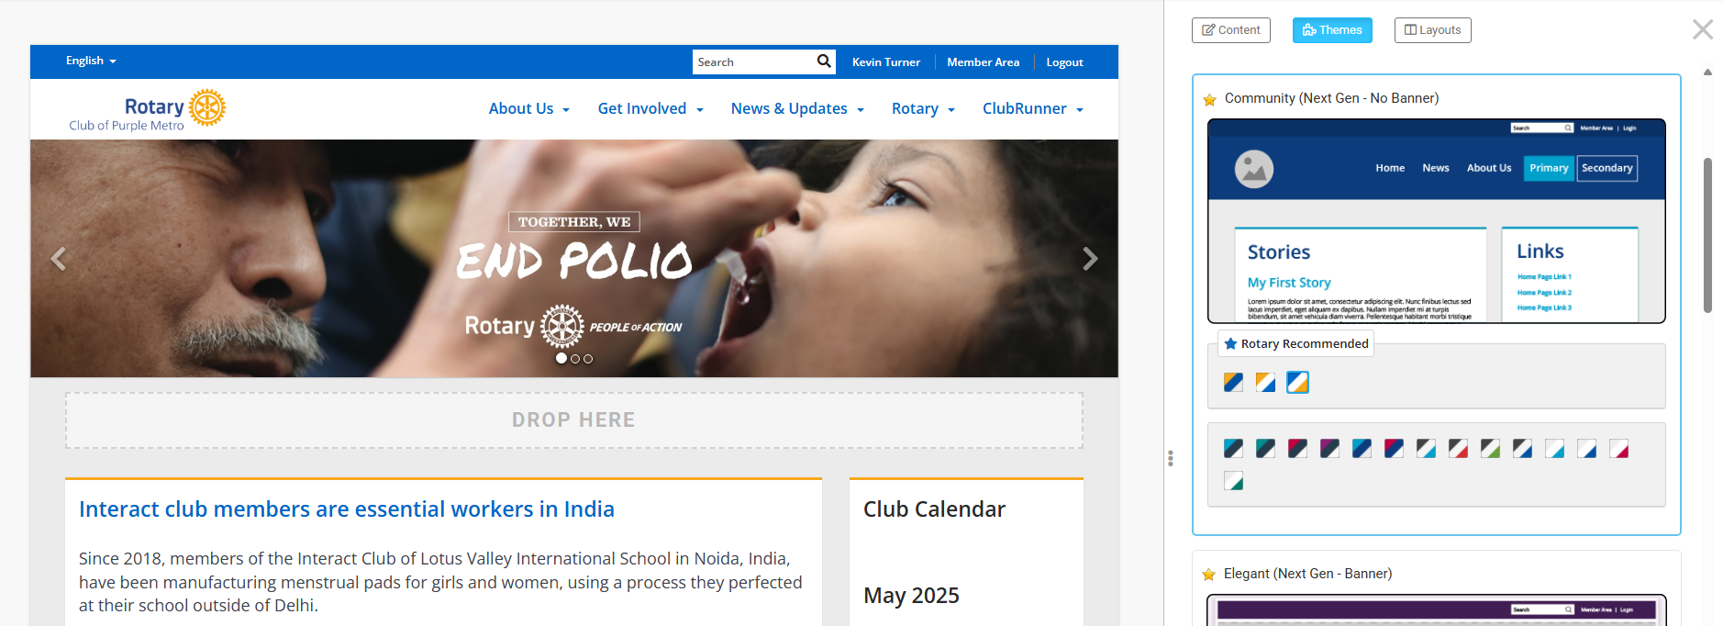
New Rotary Recommended Themes

Slide 22
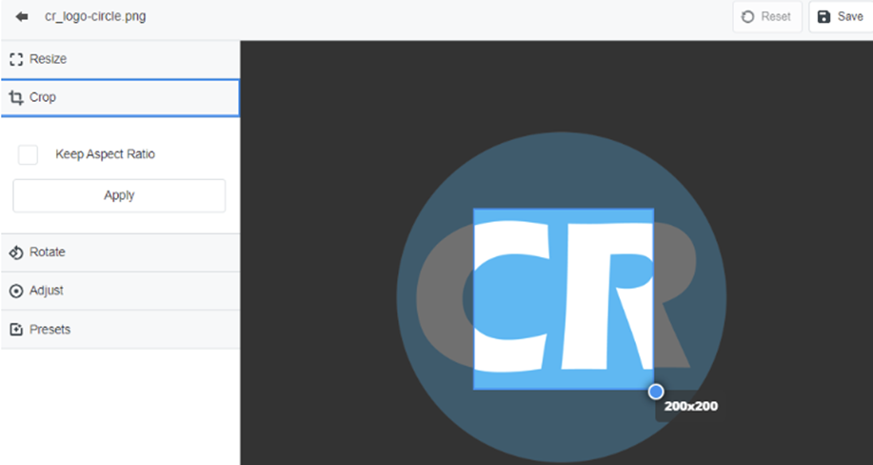
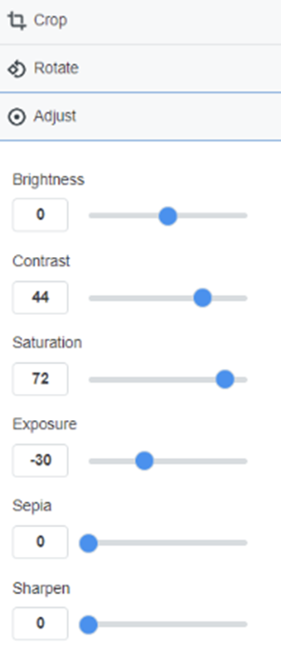
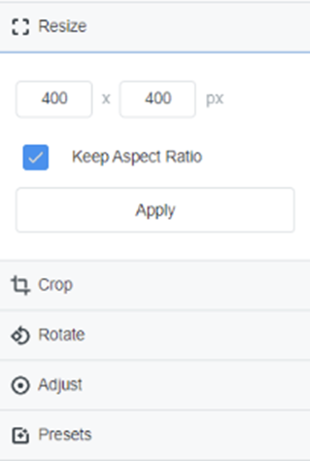
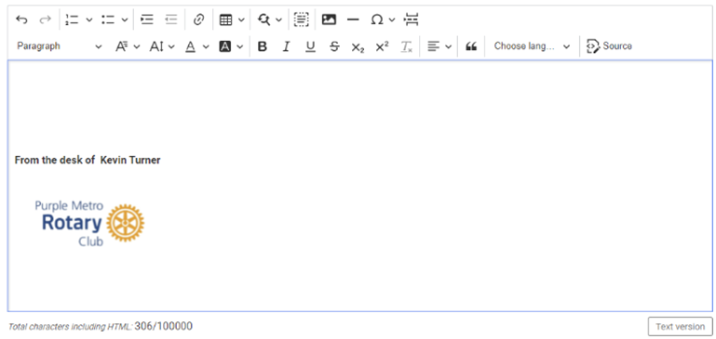
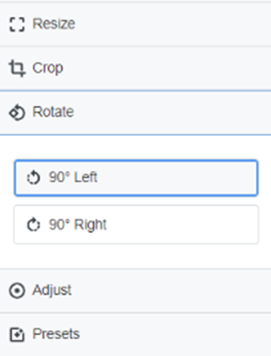
Updated HTML and Image Editor
Nova has an upgraded in-line editor to make creating content easier
Image editor will allow you to crop, resize, flip, and rotate images

Slide 23
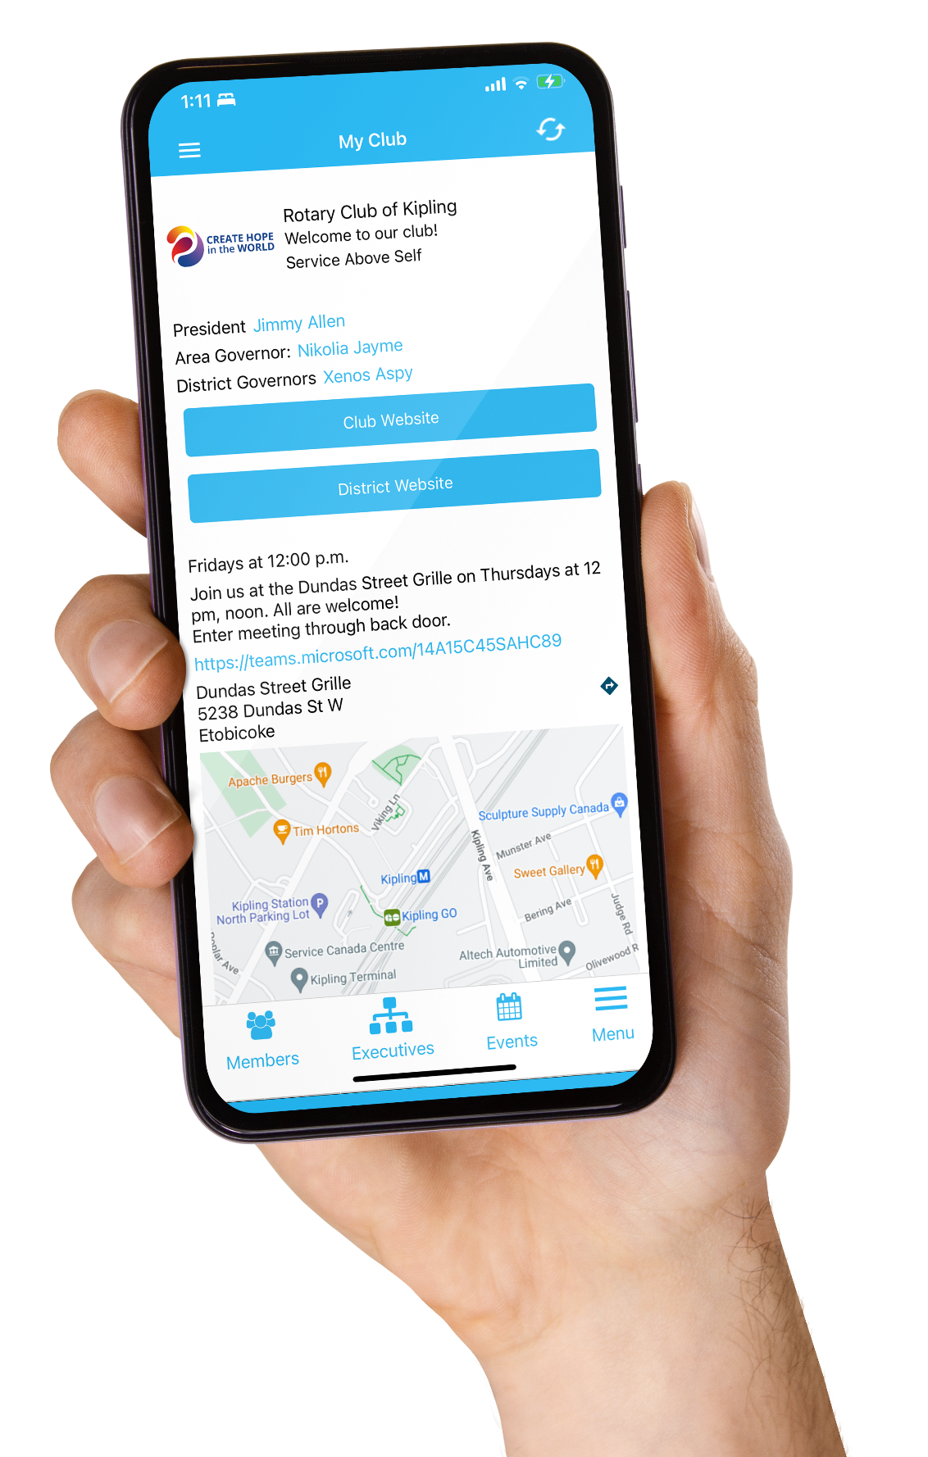
Mobile App Revamp
VERSION 4.7
New features include:
New Menu & Dashboard
Foundation Recognition
Donation Campaigns
All events listing (club, area, district)
Calendar view of all events
Birthdays & Anniversaries
Streamlined login with biometrics
Chat & Notifications
Share your contact info
Send an email
View and pay invoices
…and more!
Learn more https://www.clubrunner.com/mobile

Slide 24

ClubRunner for Rotaract Clubs
FREE!
Available at no cost to any Rotaract club within a subscriber District
Full club version (website, membership, bulletins, billing, cloud events, donations, mobile app, and more)
Dedicated Rotaract website template and colour scheme
Integrated member information with District and RI
To get started, a Rotaract club officer can fill out our Order Form at www.clubrunner.com and indicate their District ID.

Slide 25
How to switch
Email support@clubrunner.com
  We’ll connect you with a dedicated district representative
  Your representative will schedule a kickoff call to:
    Walk through the next steps
    Set a date for your district to switch
    Plan training for your team
No downtime
Better experience for everyone

Slide 26



Training
Webinars
Knowledgebase
Support Team
Join our training webinars to explore features, see them in action and learn how to get the most out of ClubRunner.
Find step-by-step guides, helpful articles and on-demand videos which answer common questions, whenever you need them!
Need a hand? Our support team is available through phone or email to answer your questions and help you and your district get started.
www.clubrunner.com/webinars
www.clubrunnersupport.com
www.clubrunner.com/contact

Slide 27
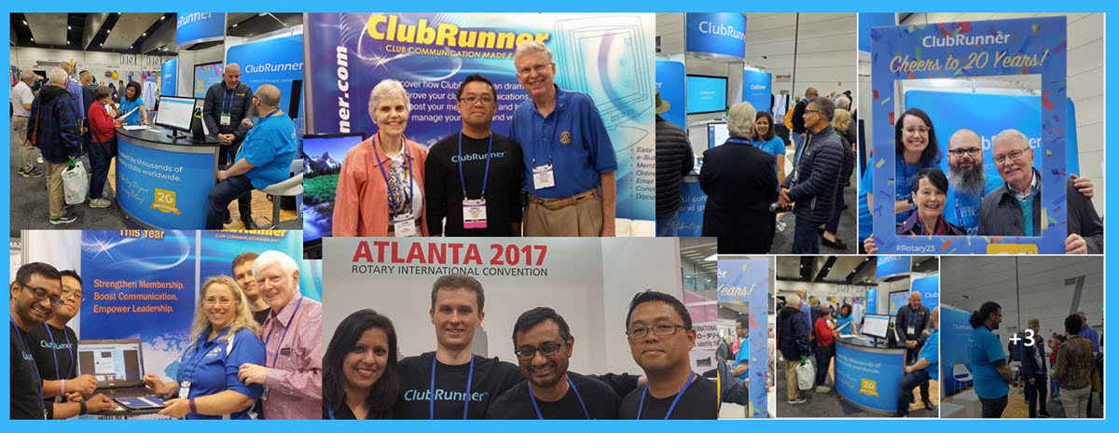
Our Promise
We remain as committed as ever to delivering world class software to Rotary clubs and districts, backed by excellent customer service.

